Slide 1



RenTcoach
Get a quick estimate of your flat’s rental value

Slide 2

The context
Wonder what rent you could claim based on most relevant features
Target
Particulars willing to deal with the renting by themselves
Real estates willing to automate price estimations
Notes:
LiveSlide https://fmicand.carto.com/builder/58cd376c-c5e7-11e6-9cbc-0e05a8b3e3d7/embed

Slide 3
The idea
Screen renting value of flats/houses announced on specialised websites
Build estimator model using machine learning
Embed the algorithms in a website with a nice GUI to allow users to perform queries in an easy manner

Slide 4
Our plan
Use Idealista’s API to obtain raw data
Clean the data and define more relevant features
Train several models and pick the best one
Construct the model by carefully ranking the features
Build a database
Create a website

Slide 5
Outline
Getting and storing data
Cleaning the data
Building the model
Building a website app

Slide 6
Outline
Getting and storing data
Cleaning the data
Building the model
Building a website app

Slide 7
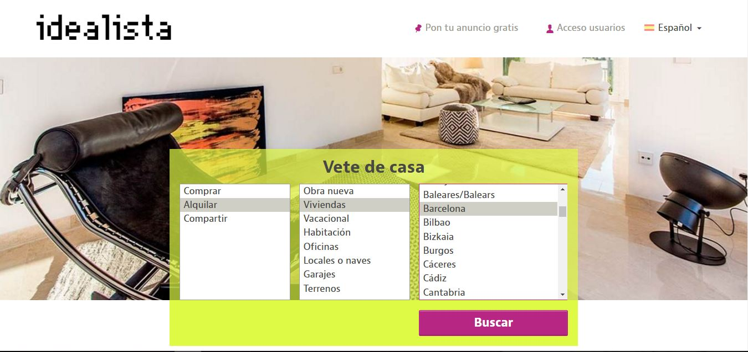
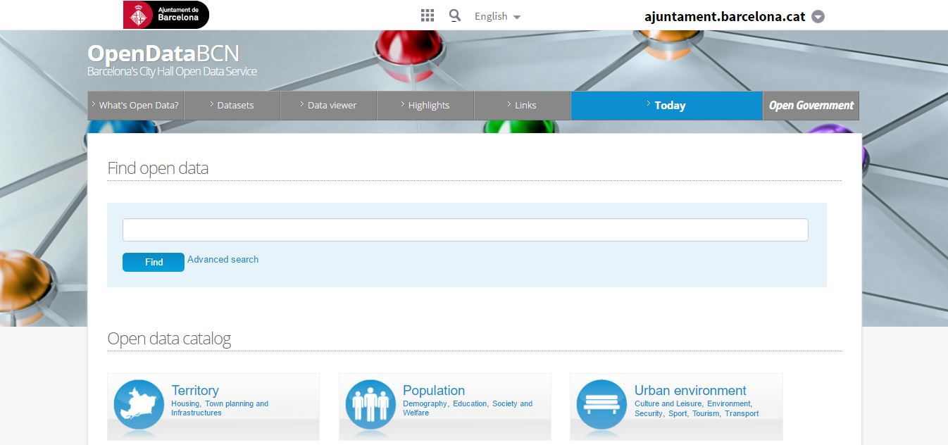
Data Source
Idealista API
OpenDataBCN
http://idealista.com
http://opendata.bcn.cat
Notes:
Idealista API data. Features examples: flat’s size in squared meters, number of rooms and bathrooms, lift, parking, floor, etc. (November 2016)
OpenDataBCN: Average price per neighborhood (October 2016)

Slide 8

Data ETL
JSON
Preliminary Data Cleaning
CSV
Idealista API
100 req/Mo=5000 flats/Mo
1 req/s
Location centered req
2 credentials
CSV
Postgre DB
CSV
Merging this feature with the properties
OpenDataBCN
Average price per neighborhood
Notes:
Manual ETL. Can be automatize but in the future if we have a less restricted access to Idealista’s API.
Generic data cleaning to load the most complete and valid dataset to the DB: drop non informative features, keep flats where “municipality”=Barcelona, replace string per number in “floor”, convert some feature to numeric, combine some features (“propertyType” and “Typology”), create dummies (“district”)
More specific data cleaning (remove outliers for instance) done just before applying the regression model.

Slide 9
Outline
Getting and storing data
Cleaning the data
Building the model
Building a website app

Slide 10
Data cleaning
Removal of useless features
Outlier removal
Dummies from categorical data
Features from user input
NaNs / missing data
Extra features

Slide 11
Data cleaning
Removal of useless features
Preliminary feature selection from the data provided by the idealista API
Useless features: Property code, numPhotos, url, thumbnail
NaNs / missing data

Slide 12
Data cleaning
Outlier removal
Mostly found in the price feature
Clear negative effect on accuracy
Keep data between percentiles 2.5 and 89

Slide 13
Data cleaning
Dummies from categorical data (typology and the status of the flat)
Dummies for the district, status and the typology
Merge different typology features: Typology and subtypology
Also dummies from Neighbourhood. But it supposed no improvement in accuracy. Too many features.

Slide 14
Data cleaning
Features from user input
Latitude and longitude from adress and postal code
Random forest perfectly deals with continuous features, it has threshold value in each node over some chosen feature at this node
Extra features
Statistics on price by area added from open data Barcelone

Slide 15
Outline
Getting and storing data
Cleaning the data
Building the model
Building a website app

Slide 16
Model selection
Comparison criteria: best mean absolute error result on the test set obtained via Gridsearch (and trying different complexities of the model for *):
Model | Mean absolute error
Linear Regressor * | 341.07
Ridge Regressor * | 341.09
Gradient Boosting Regressor | 257.90
Random Forest Regressor | 234.69
Support Vector Regressor | 497.68

Slide 17
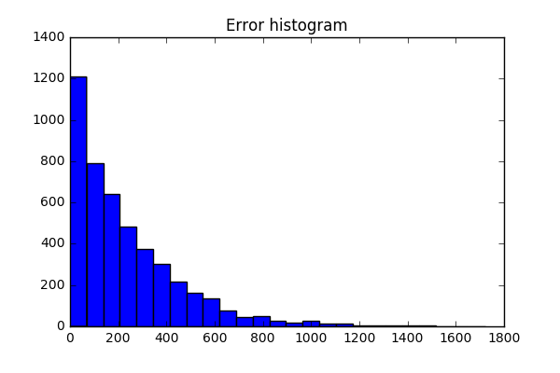
Random forest regressor
Best parameters using Gridsearch and scoring the mean absolute error:
n_estimators=200
max_features='sqrt’
bootstrap=False
Mean absolute error using Cross validation using all features: 234.69€

Slide 18
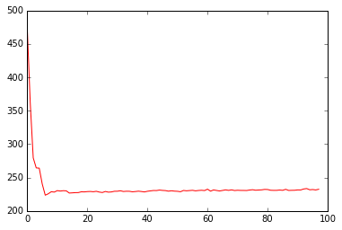
Recursive Feature Election
Best mean absolute error (223.57€) is obtained for 7 features:
'rooms', 'bathrooms', 'size', 'floor','longitude','latitude', 'priceperarea'

Slide 19
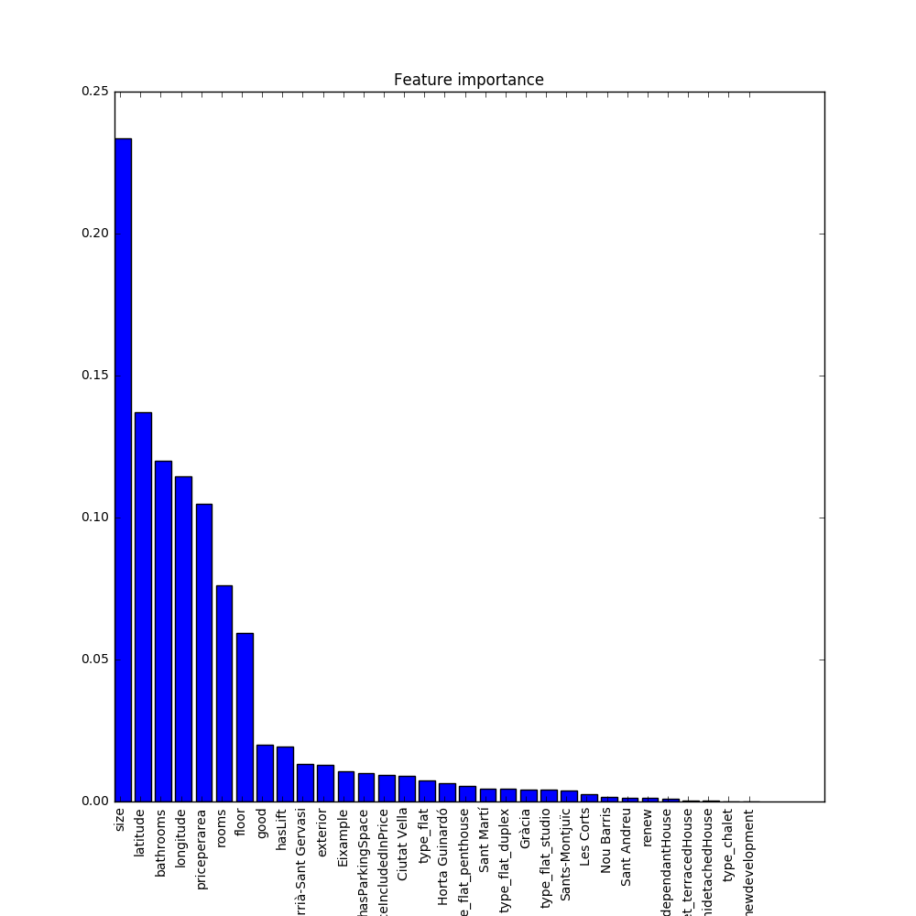
Features importance
Top 7 features
(85% of total weight):
size
latitude
bathrooms
longitude
priceperarea
rooms
floor

Slide 20
Outline
Getting and storing data
Cleaning the data
Building the model
Building a website app

Slide 21
Staging and Production Environments using Django

Slide 22
Staging and Production Environments using Django
Phase 1: Development
Finding the right host
Python Notebooks vs App Environment
Containers
Frameworks
Integration
Building a MVP (Minimum Viable Product)

Slide 23
Staging and Production Environments using Django
Phase 2: Staging
Installing Django
Creating Models
Set up web containers/frameworks.
Deploying
Testing
Debugging

Slide 24

Staging and Production Environments using Django
Phase 3: Production
Deployment
Launching our MVP
Tracking
www.rentcoach.us

Slide 25
Thank you!
Work presented on 22 Dec. 2016 as part of the Agile Data Science course of the Master FDS.
Team RentCoach members were:
Alexandre Escolà
Erwan Guillotel
Florent Micand
Jaume Puigbò
Manel Maragall
Samuel Sánchez
Valentín Ramírez

